Slide 1
Requirements management in MATLAB
Testing and validation platforms
Master’s Degree in Smart Energy Systems

Slide 2
Content
Introduction to MATLAB Requirements editor.
Requirements Editor.
Requirements tracking.
Requirements analysis.

Slide 3
Introduction
1

Slide 4
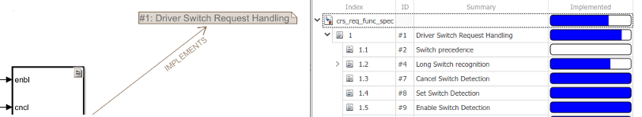
Introduction
In energy systems, we usually use MATLAB & Simulink for design and validation.
MATLAB Requirements Toolbox enables you to author, organize and edit requirements.
Requirements can be linked to Simulink components, which makes the work of validation easier. Everything is in the same place.

Slide 5
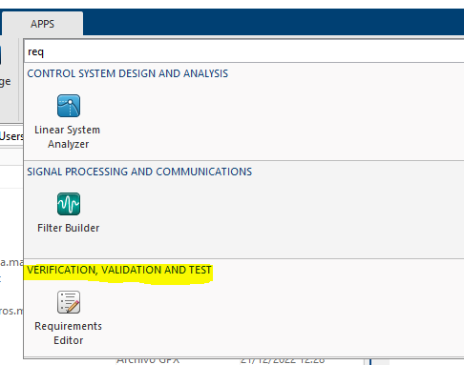
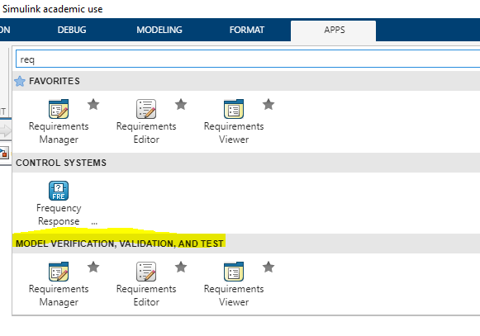
Introduction
Requirements Toolbox has three main tools:
Requirements Editor: author, organize, import and edit requirements.
Requirements manager: link requirements to Simulink Models.
Requirements viewer: customize requirements views in Simulink.
In MATLAB
In Simulink

Slide 6
Example
Let’s see an example of requirements management in MATLAB & Simulink.
Let’s check:
The requirements Editor.
Requirements in Simulink.
Cruise Control requirements
(execute openProject("CruiseRequirementsExample") in
MATLAB command window OR Access https://es.mathworks.com/help/slrequirements/gs/link-blocks-and-requirements.html)

Slide 7
Requirements editor
2

Slide 8
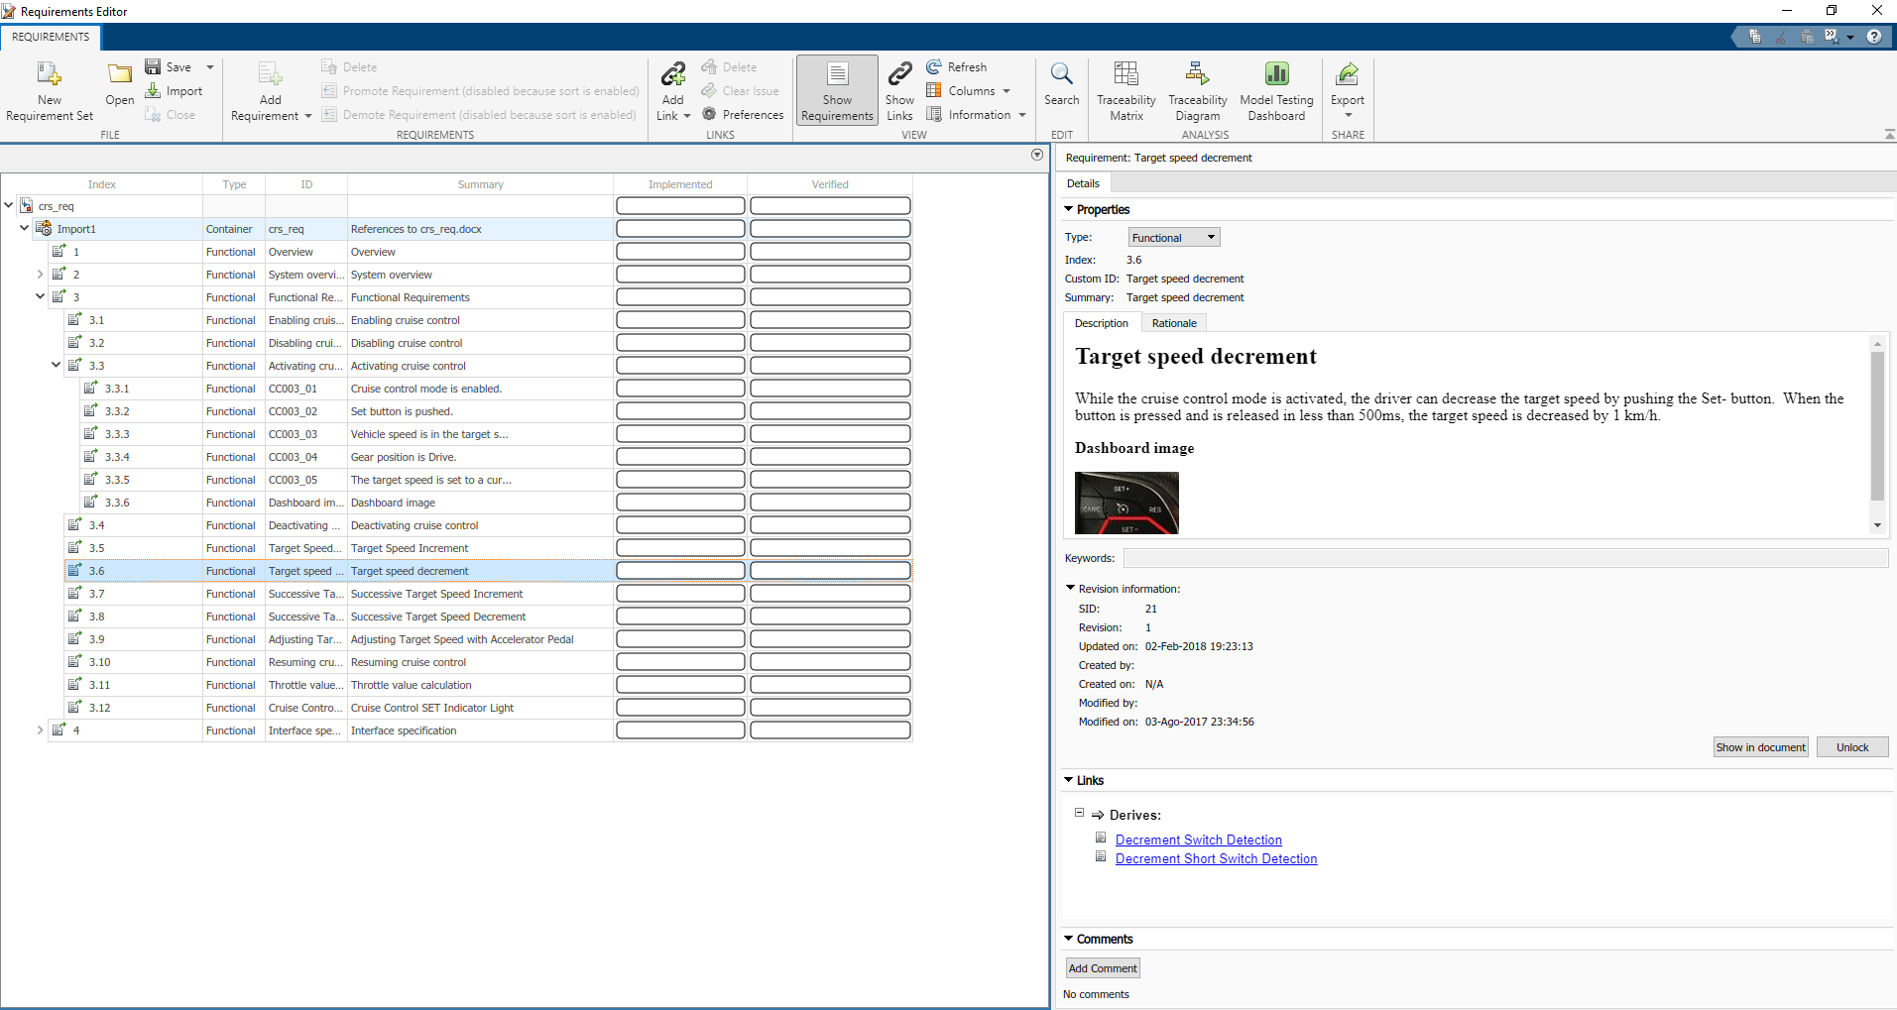
Requirements editor
Requirements Editor is the main tool to author, organize and edit requirements (file \documents\crs_req.slreqx).
Requirement details
Requirement set

Slide 9
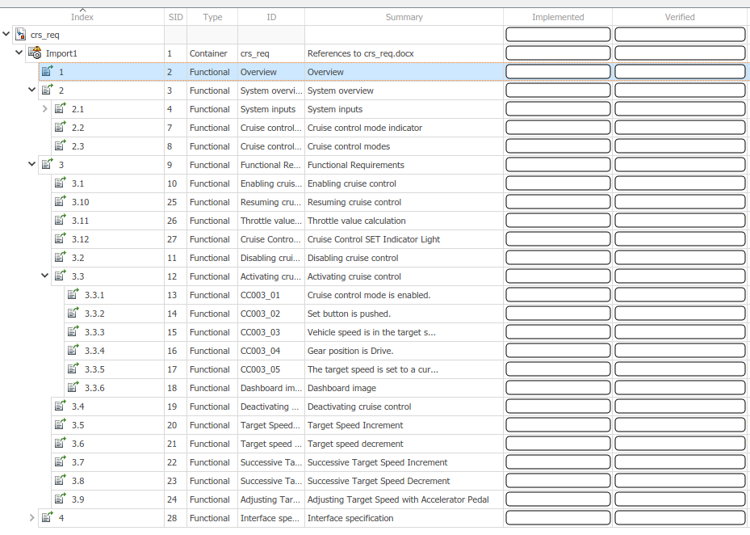
Requirements editor
A requirement is specified by the following attributes:
Index: Index number, reflects structure of requirements set.
SID: Single identifier. Unique identifier created by MATLAB.
Custom ID: Custom identifier specified by user.
Summary: Summary of the description.
Implementation status: Shows progress of implementation.
Verification status: Shows progress of verification.

Slide 10
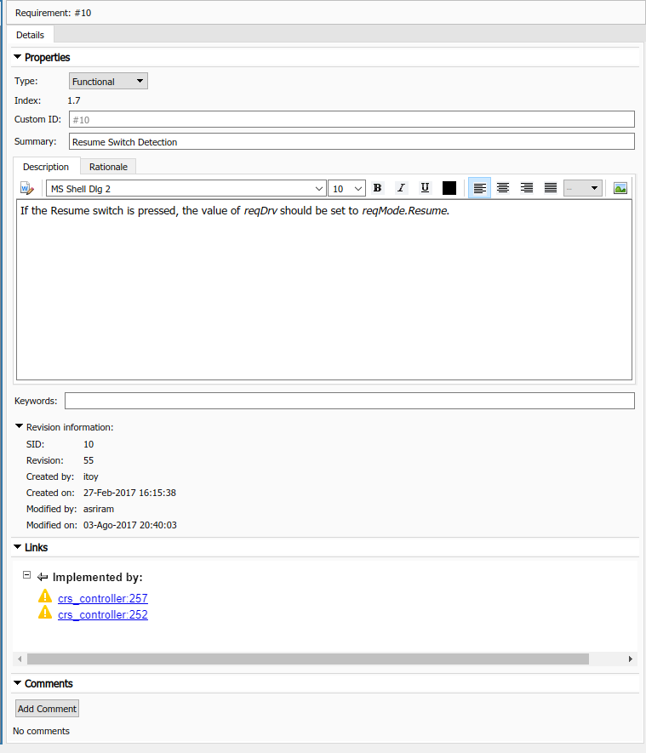
Requirements editor
A requirement is specified by the following attributes:
Description: text and image description.
Rationale: Justification of the existence of the requirement.
Keywords: enable filtering.
Revision information: ModifiedBy, SynchronizedOn, ModiifiedOn, CreatedBy, CreatedOn.
Links: links to other requirements, Simulink components…
Comments

Slide 11
Requirements editor
A requirement is specified by the following attributes:
Type:
Functional:
Capture required functional behavior for the design.
Requirements Toolbox™ calculates the implementation and verification status for functional requirements based on the requirement links.
Container:
Organize requirements in groups and create a hierarchy. Requirements Toolbox does not include container requirements when calculating the implementation and verification status of the requirement set. However, any functional requirements under a container requirement contribute to the calculation of the statuses.
Informational:
Capture non-functional behavior or other supplemental information.
Requirements Toolbox does not include informational requirements or any requirements under them when calculating the implementation and verification status of the requirement set.

Slide 12
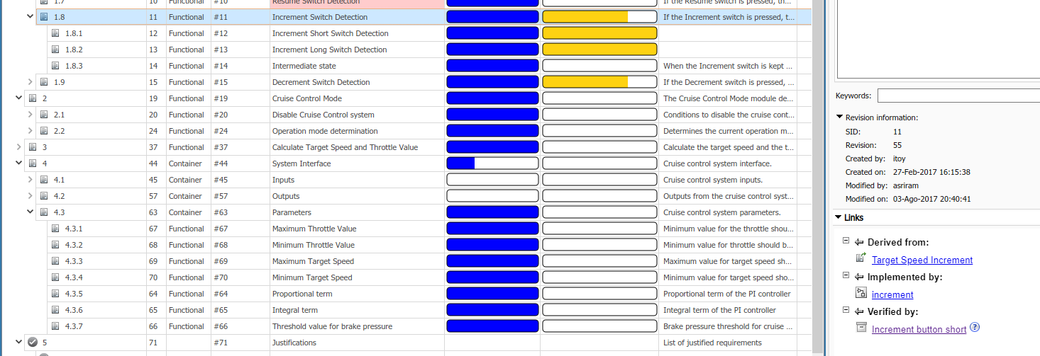
Requirements editor
A requirement is specified by the following attributes:
Implementation status: shows the progress of implementation based on the implementation links.
Verification status: shows the progress of implementation based on the verification links and Simulink Test.
\documents\crs_req_func_spec.slreqx
Another requirement
Simulink model
Simulink Test

Slide 13
Requirements editor
There are two ways of creating requirements:
Manually in Requirements Editor.
Importing from:
Microsoft Word Document
Microsoft Excel Spreadsheet
ReqIF file (*.reqif or *.reqifz)
IBM DOORS Next

Slide 14
Exercise. Scooter motor requirements
This exercise is available on Mudle and GitHub.
Tasks:
Download motor customer requirements slx.
Write two system requirements for the motor.
Create requirement set and requirements in Requirement Editor.
Write attributes.
Finish the whole requirements set.

Slide 15
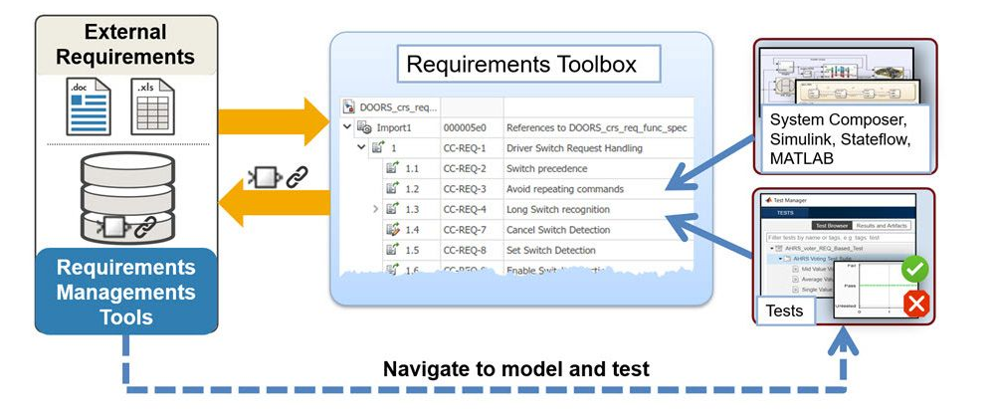
Importing requirements from sheets
Requirements can be imported from Excel spreadsheets.

Slide 16
Importing requirements from sheets
Requirements formatting in spreadsheets:
Requirements must have a specific format in the spreadsheets.
Attributes are columns.
Default or custom attributes can be specified.

Slide 17
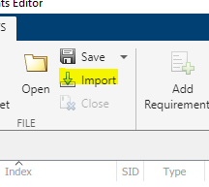
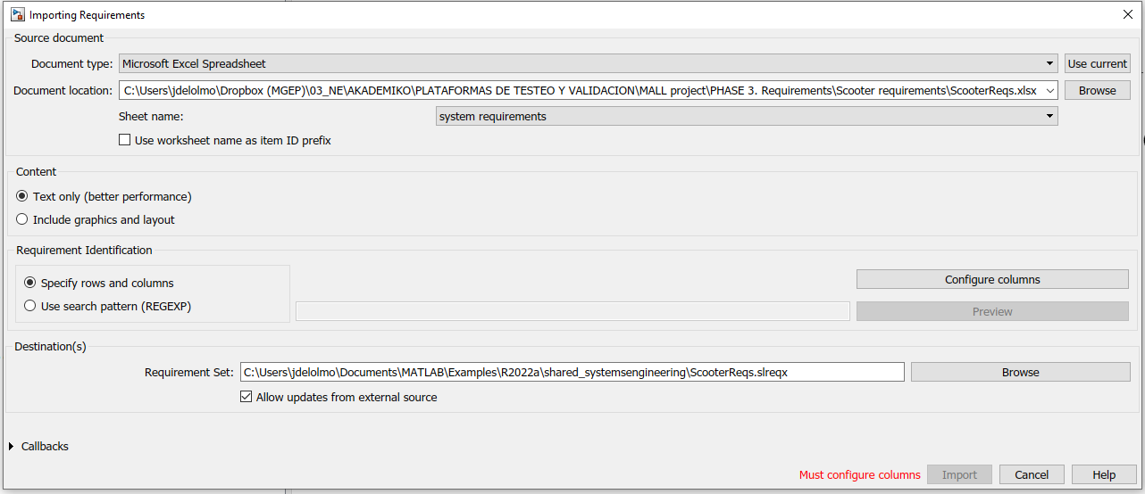
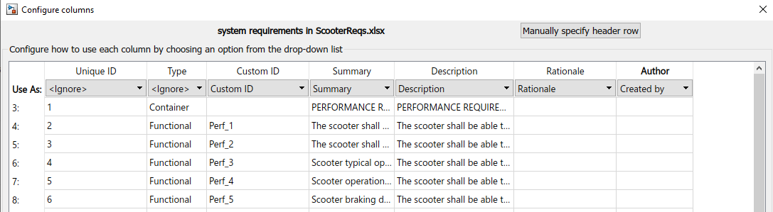
Importing requirements from sheets
Step 1. Open Requirements editor and click Import.
Step 2. Specify source document
Step 3. Configure columns
Default or custom attributes can be specified.

Slide 18
Importing requirements from sheets
Step 4. Specify destination. Requirements in MATLAB are saved in a slreqx file.
Step 5. Specify update configuration.
Editable: import from requirements and update and modify in MATLAB (document is not updated).
Read-only: changes can only be made in the source document and Requirements Editor is updated.
Step 6. Import requirements

Slide 19
Importing requirements from sheets
Requirements set customization
Additional operations when importing requirements can be programmed in MATLAB functions (callbacks).
Example: https://www.mathworks.com/help/slrequirements/ug/import-requirements-from-microsoft-excel.html

Slide 20
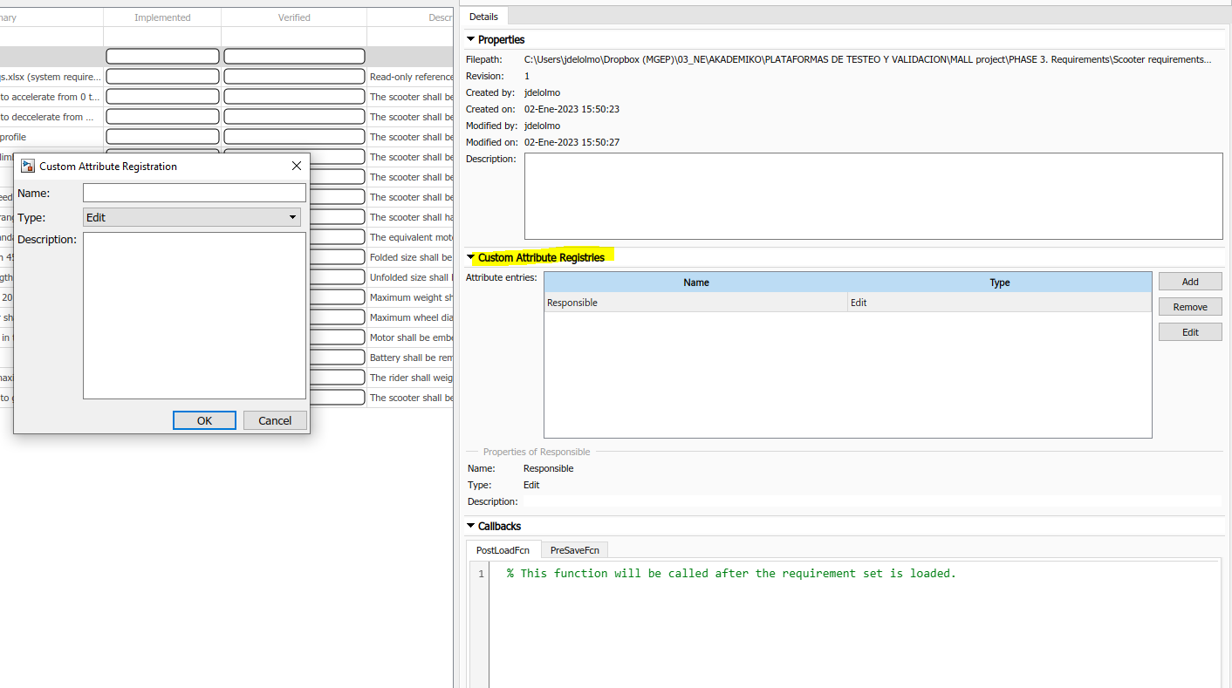
Importing requirements from sheets
Requirements set customization
Requirement sets can be customized with Custom Attributes and Callbacks.

Slide 21
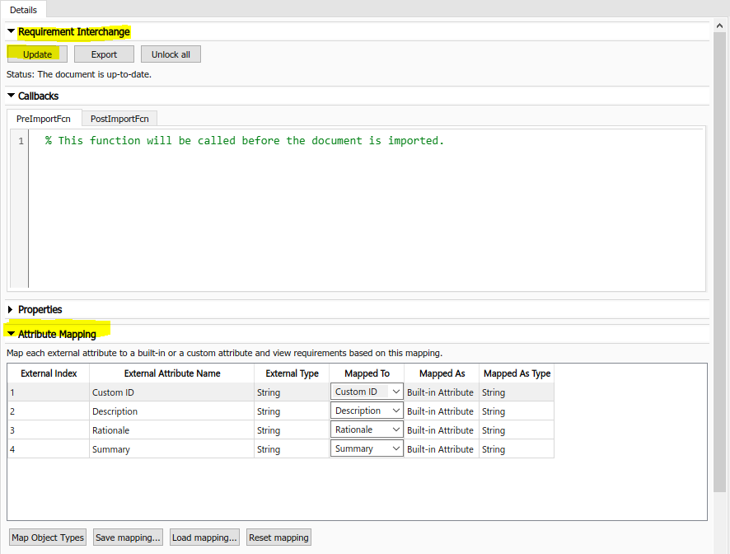
Importing requirements from sheets
Import customization
If requirements are read-only, changes must be made in the original file. The requirements set is updated in the requirement Interchange tab.
Attribute mapping can be configured in the Attribute Mapping tab.

Slide 22
Requirements tracking
3

Slide 23
Requirements tracking
Requirements toolbox enables tracking the implementation and validation of requirements.
Tracks how requirements are mapped to a design.
Tracks how the design fulfills requirements.

Slide 24
Requirements tracking
Requirements toolbox enables tracking the implementation and validation of requirements.
Implementation
Verification

Slide 25
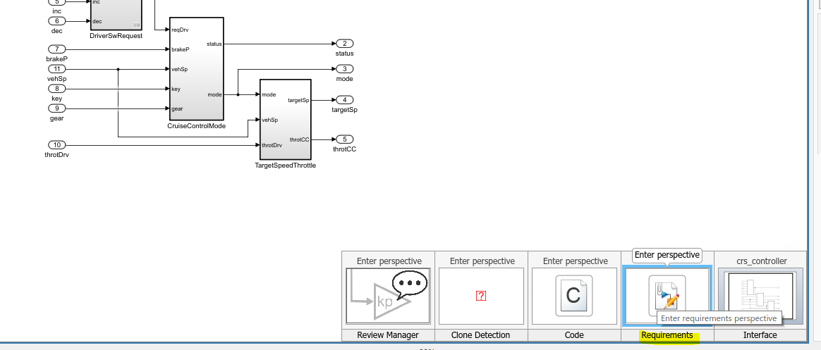
Tracking implementation
Requirements can be linked to design components.
Simulink shows the links with the requirements perspective.
\models\crs_controller.slx

Slide 26
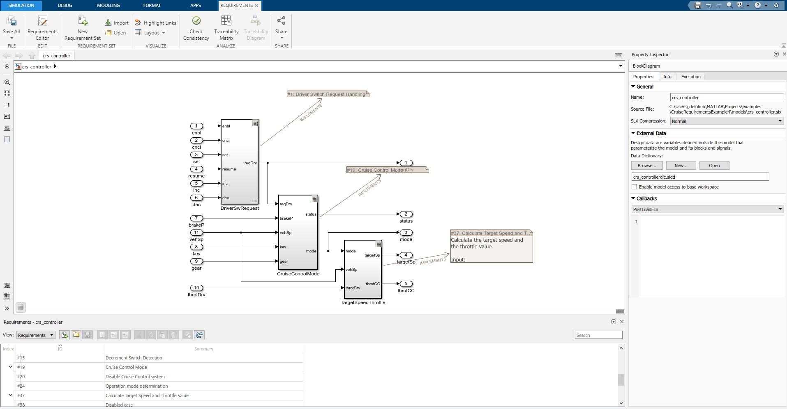
Tracking implementation
Requirements can be linked to design components.

Slide 27


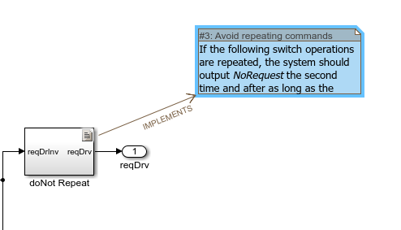
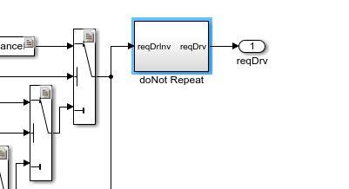
Tracking implementation
If the requirements are linked to a component, implementation status changes.

Slide 28
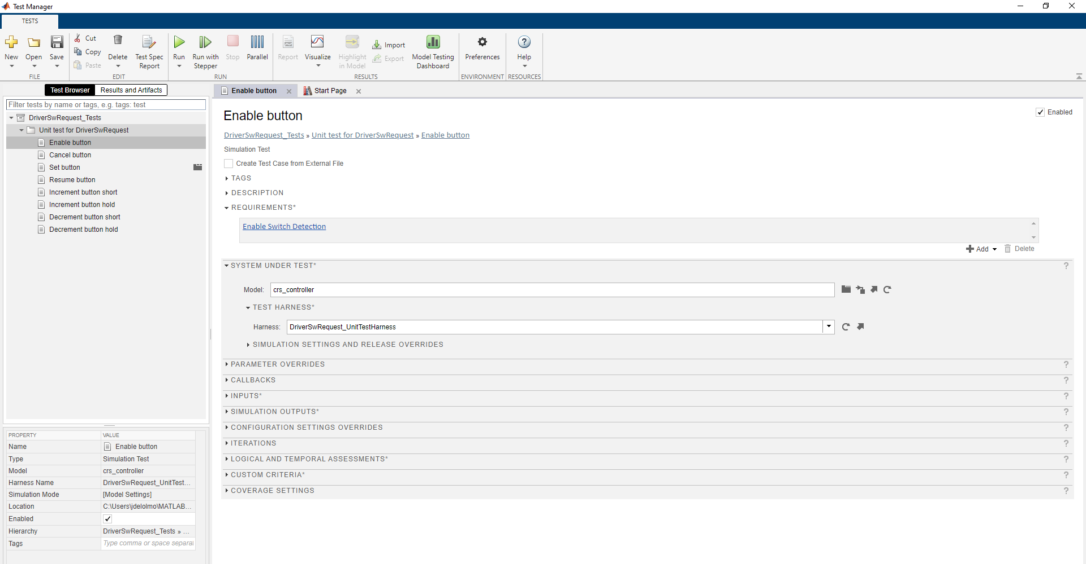
Tracking validation
A component can be linked to requirements and validation tests.
Simulink Test validates the design against requirements.
\Tests\DriverSwRequest_Tests.mldatx
Tests
Requirements
Simulink designs
to be continued in 4th module

Slide 29
Requirements analysis
4

Slide 30
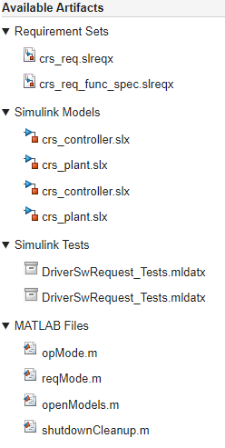
Requirements analysis
During the life cycle, a lot of information is generated.
Formally, all the tools/information are called artifacts.

Slide 31

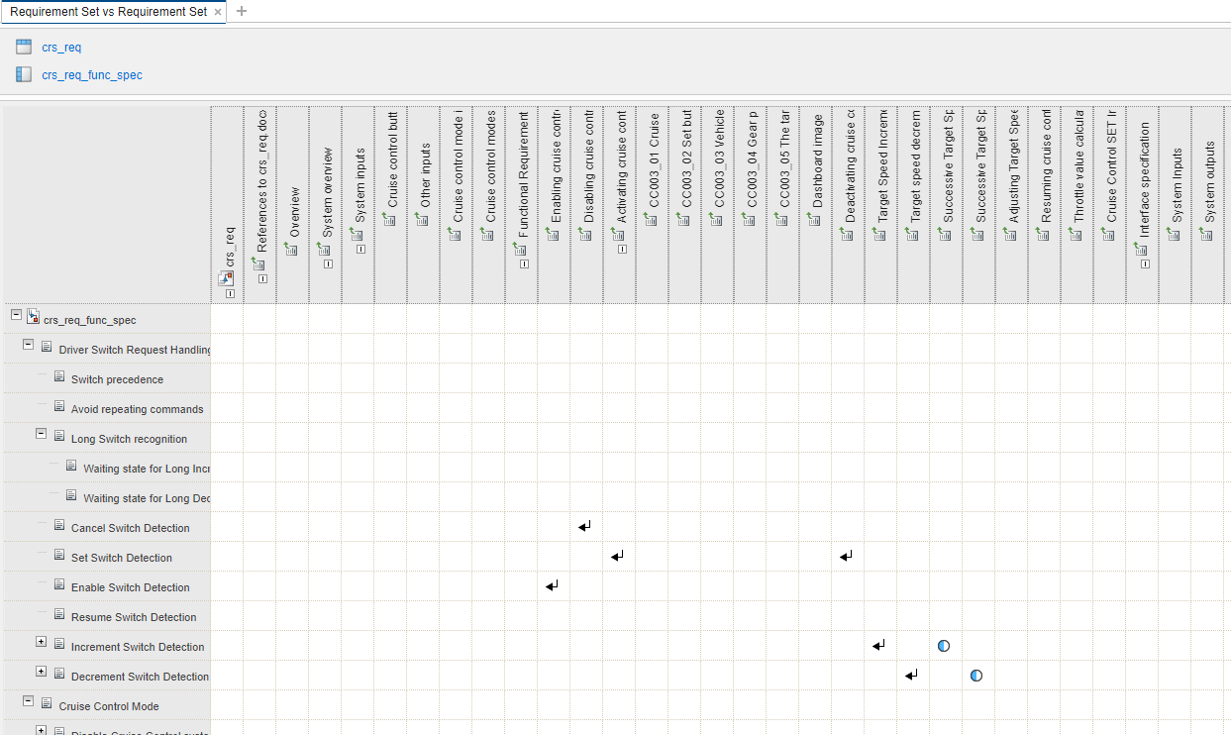
Traceability analysis
Configure a traceability matrix in Requirements Editor with the two sets available in the example
Requirements Editor enables traceability analysis.
How are sets of requirements related?
Requirements
Requirements

Slide 32
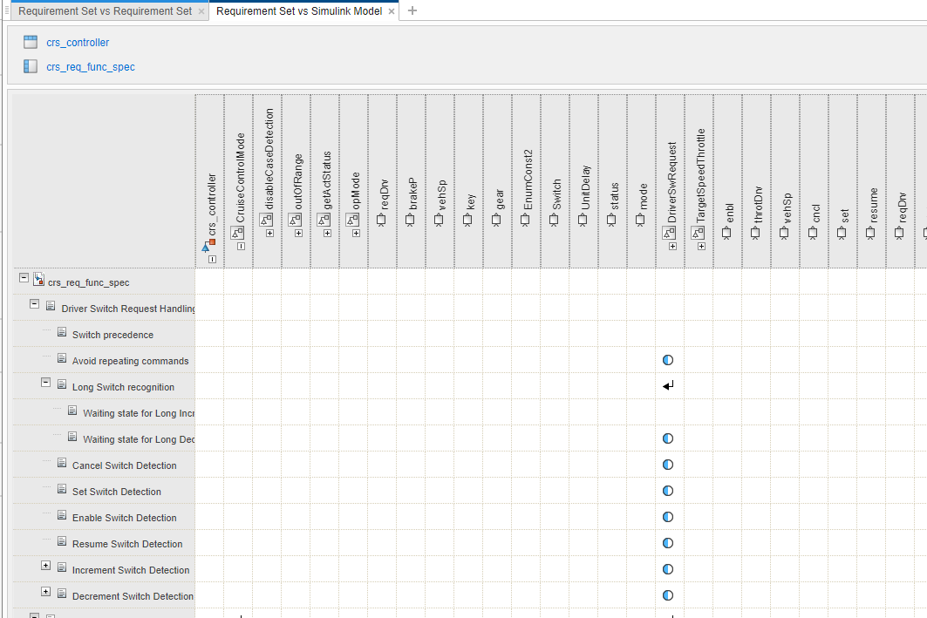
Traceability analysis
Configure a traceability matrix in Requirements Editor with the two sets available in the example
Requirements Editor enables traceability analysis.
Where are requirements implemented?
Simulink models
Requirements

Slide 33
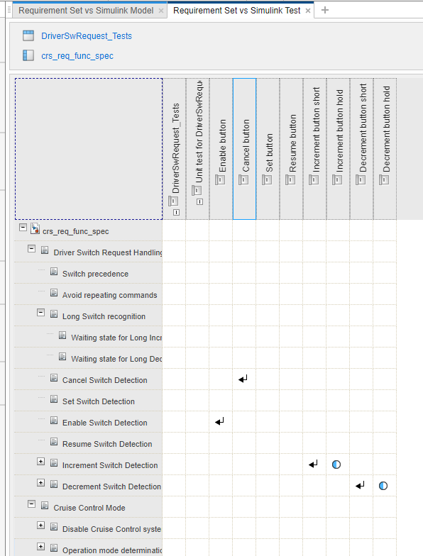
Traceability analysis
Configure a traceability matrix with on requirement set and test data
Requirements Editor enables traceability analysis.
How are components validated against requirements?
Tests
Requirements

Slide 34

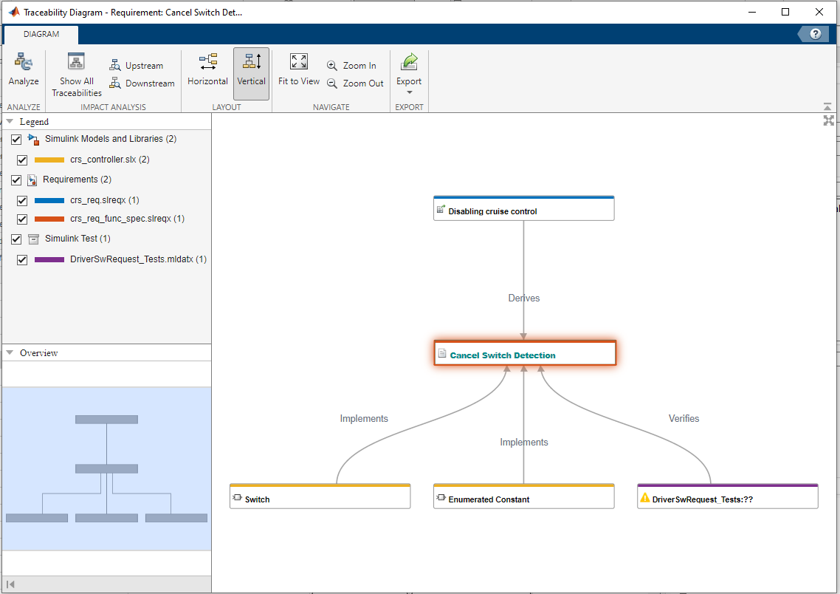
Traceability diagram
Traceability diagrams show the link between requirements, components and tests.

Slide 35
Eskerrik asko
Muchas gracias
Thank you
Jon del Olmo Larrañaga
jdelolmo@mondragon.edu
Iosu Aizpuru
iaizpuru@mondragon.edu
Paul Aretxederreta
x.paretxederreta@mondragon.edu
Galarreta Campus
Jauregi Bailara, z.g.
20120 Hernani (Gipuzkoa)
Tel. : +(34) 943 739765
www.mondragon.edu

